Slide 1
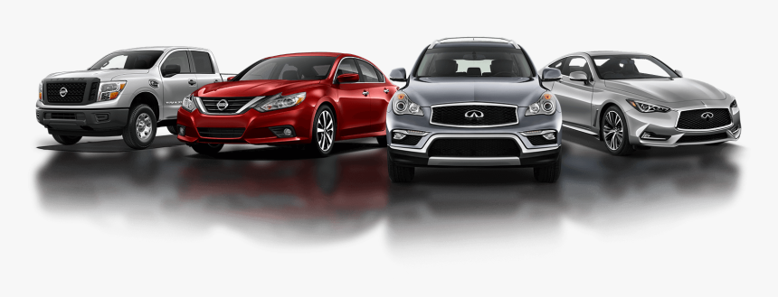
ONLINE CAR SHOWROOM

Slide 2
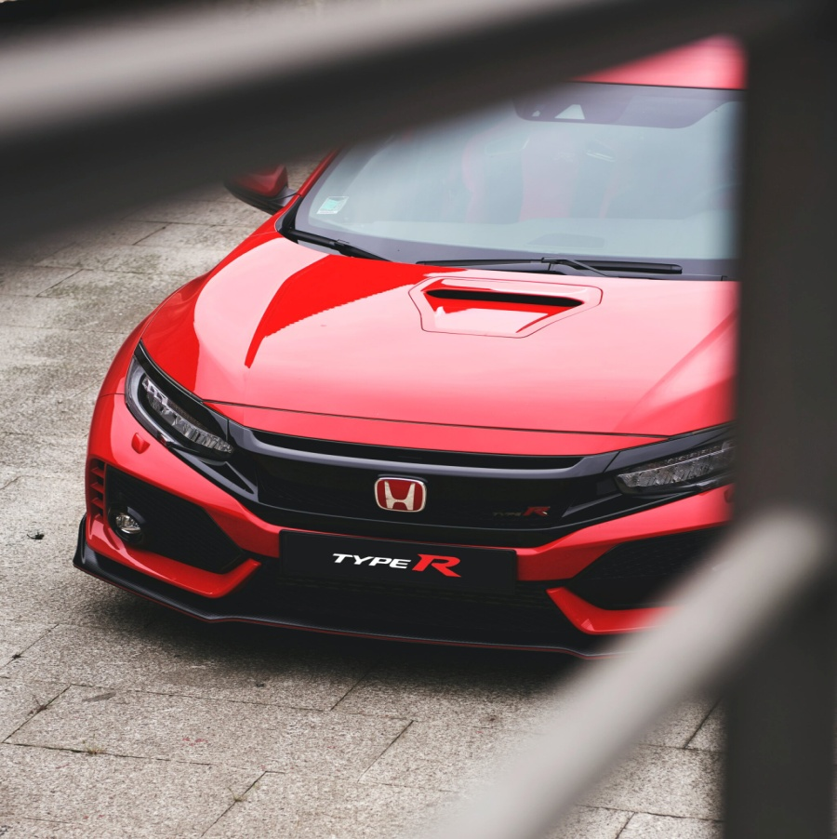
TECHNOLOGIES USED
HTML
CSS
JAVASCRIPT

Slide 3
CONTENTS
1
Abstract
2
Introduction
3
Home Page Design
4
Login Page With Code
5
Popular Vehicles Page
6
Services Page
7
Car Selling Page
8
Car Insurance
9
Featured Cars And Code
10
Reviews
11
Contact Us

Slide 4
ABSTRACT
→ This Project is aimed at developing a Web application that depicts Online Car Showroom and booking four wheeler vehicles through online.
→Since the start of the twentieth century, the role of cars has become highly important, though controversial.
→ They are used throughout the world and have become the most popular mode of transport in many of the more developed countries.
→My project aims at creating an web application which tracks customer records, online booking, online vehicle records, etc and it provides easy to use web based interface for customers where customers can search for vehicles, view a complete details, models, features, pricing of the vehicles and book the vehicles.

Slide 5
INTRODUCTION
In this website here is the complete information of cars and from this cars models website we all can know what are the different types and what are the brands of cars.
Now a days cars are very important as we need the transport to go where ever you want.
→So this website is completely based on the popular brands of cars used now a days.And booking a car through online that is nothing but Online Car Showrroom.
→For most people a car is a very important purchase decisions and with modern lifestyles it has become a necessity. Today people have many choices when it comes to cars but the basic experience is about the same. All cars are equally reliable and offer material standards matching their class.
→ This system will allow users to easily purchase cars from dealers on a web – based interface.

Slide 6
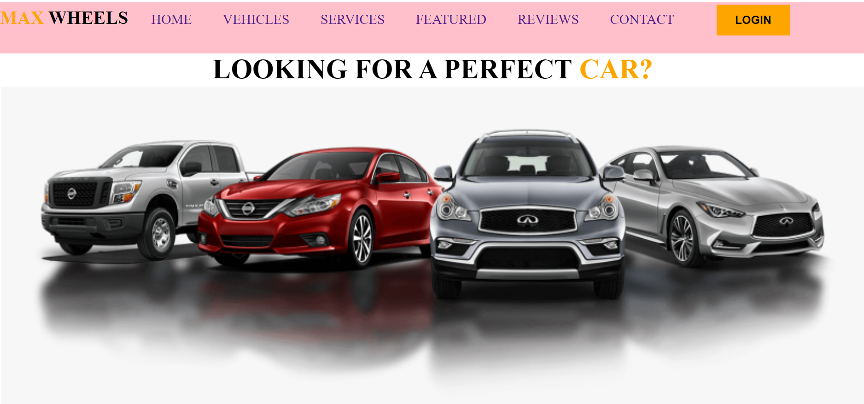
HOME PAGE DESIGN

Slide 7
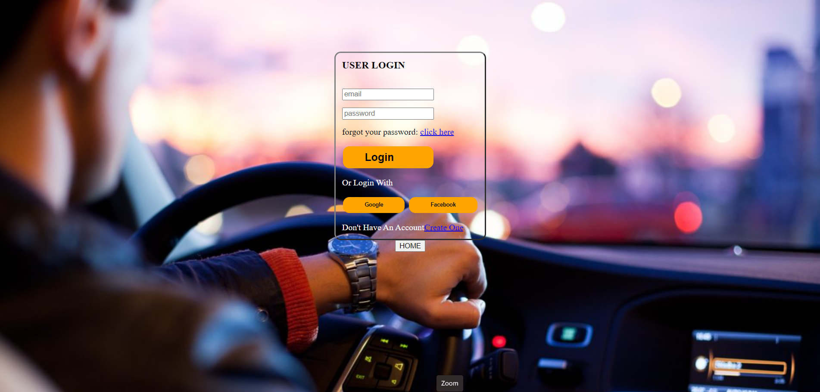
LOGIN PAGE

Slide 8
Login Page Code
<html>
<head>
<title> login page </title>
<style>
td{border:none;}
table{border-radius:12px}
button{border-radius:12px}
a:hover{color:orange}
button:hover{
opacity:0.8;}
.button {
background-color: orange;
border: none;
padding: 9px 40px;
text-align: center;
text-decoration: none;
display: inline-block;
margin: 4px 2px;
cursor: pointer;
}
.button1{font-size: 20px;}
</style>
<style>
body
{
background-image:url("carbackground.jpg");
background-size:100%;
background-attachment:fixed;
background-repeat:no-repeat;
}
</style>
</head>
<body >
<form name=" User Login" action="serveraddress">
<center>
<table border=3 cellpadding=2 cellspacing=10>
<tr><td><h3><b> USER LOGIN </b></h3></td></tr> <br>
<tr>
<td><input type="email" placeholder="email"></td> <br>
</tr>
<tr>
<td><input type="password" name="pw" placeholder="password"></td> <br>
</tr>
<tr><td>forgot your password: <a href="click here">click here</a></td></tr><br>
<tr><td><button class="button button1"><b>Login &nbsp &nbsp &nbsp </b></button></td>
<tr><td><font color="white"> Or Login With </font></td></tr><br>
<td><button class="button button2"><b>Google</b></button>
<button class="button button3"><b>Facebook</b></button></td></tr>
<tr><td> <font color="white">Don't Have An Account<a href="Create One">Create One</a></font></td></tr>
</table>
<a href="projecthome.html">
<tr><td><input type="button" name="b" value="HOME"></td></tr></a>
</center>
</body>
</html>
<tr><td><font color="white"> Or Login With </font></td></tr><br>
<td><button class="button button2"><b>Google</b></button>
<button class="button button3"><b>Facebook</b></button></td></tr>
<tr><td> <font color="white">Don't Have An Account<a href="Create One">Create One</a></font></td></tr>
</table>
<a href="projecthome.html">
<tr><td><input type="button" name="b" value="HOME"></td></tr></a>
</center>
</body>
</html>

Slide 9
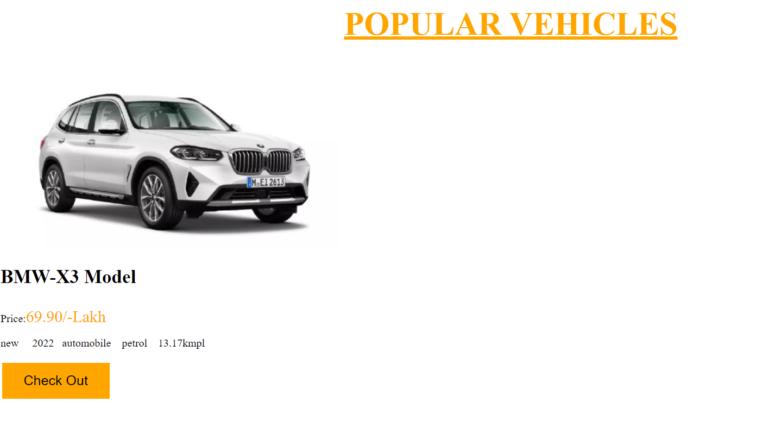
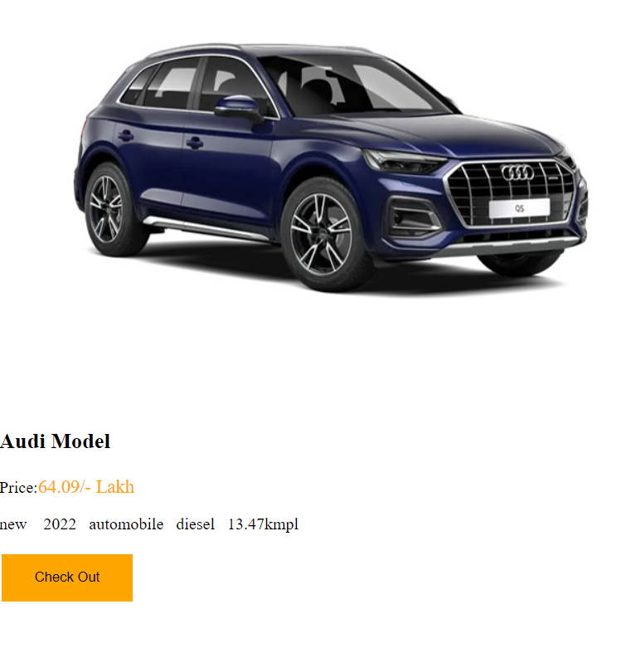
POPULAR VEHICLES

Slide 10
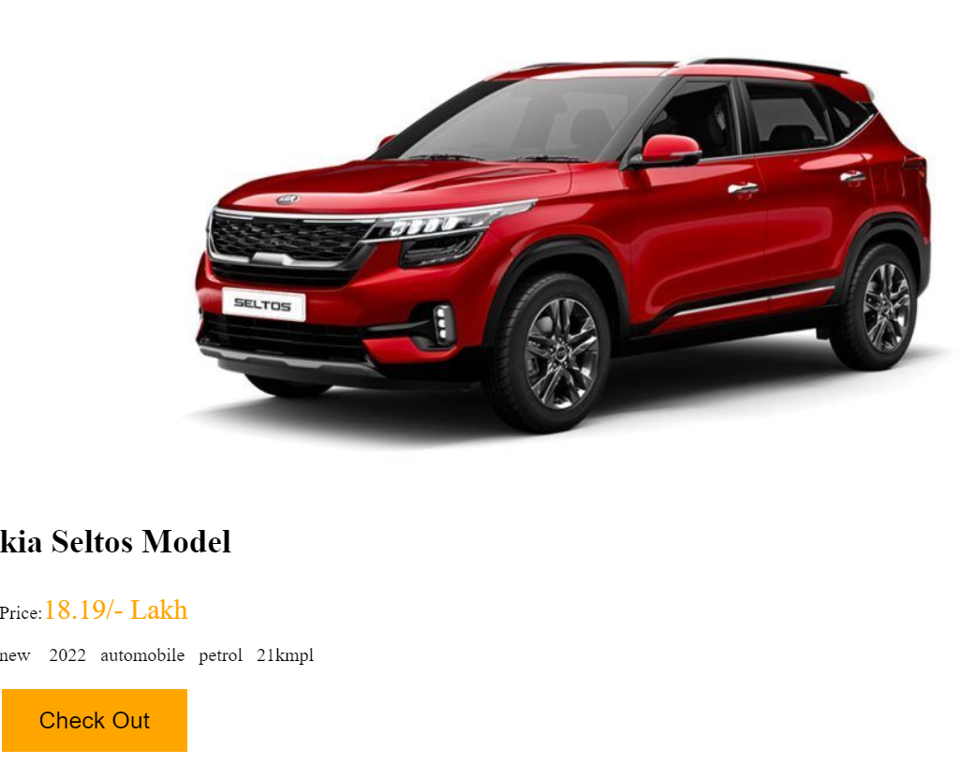
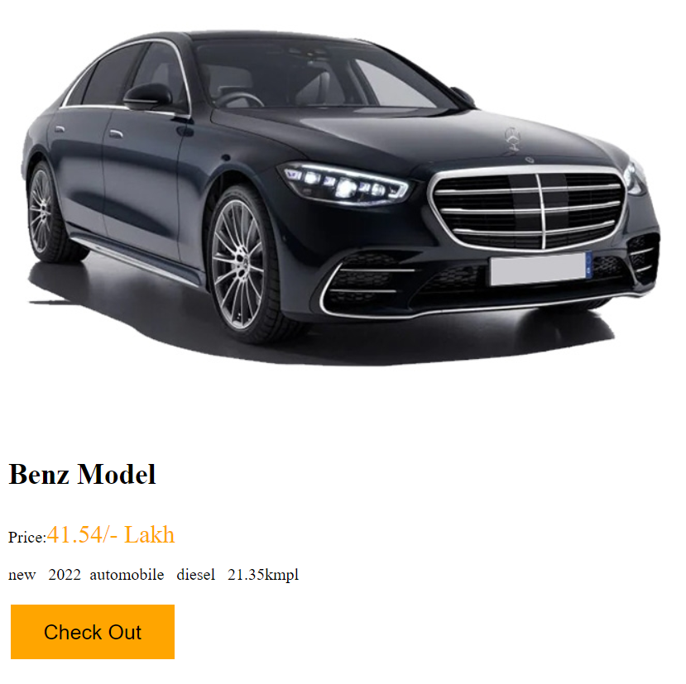
VEHICLES

Slide 11
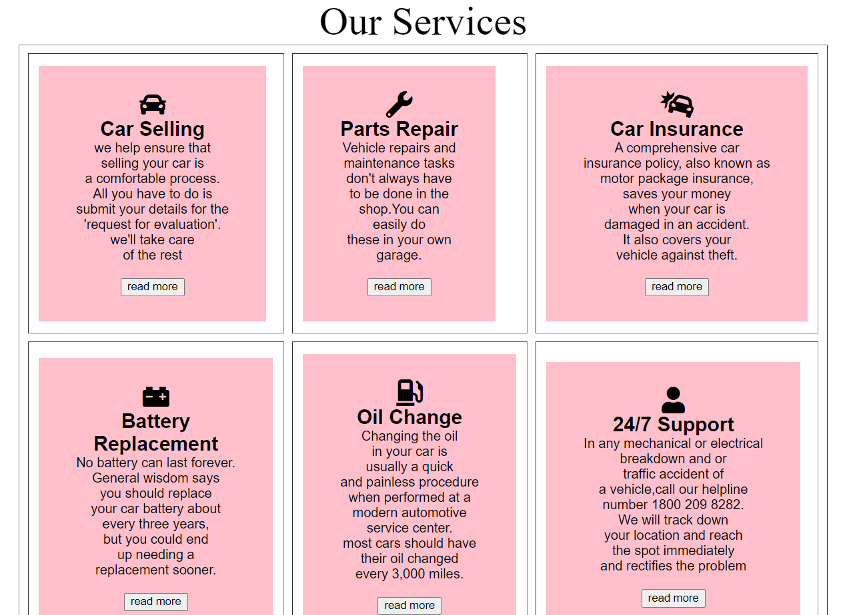
SERVICES

Slide 12

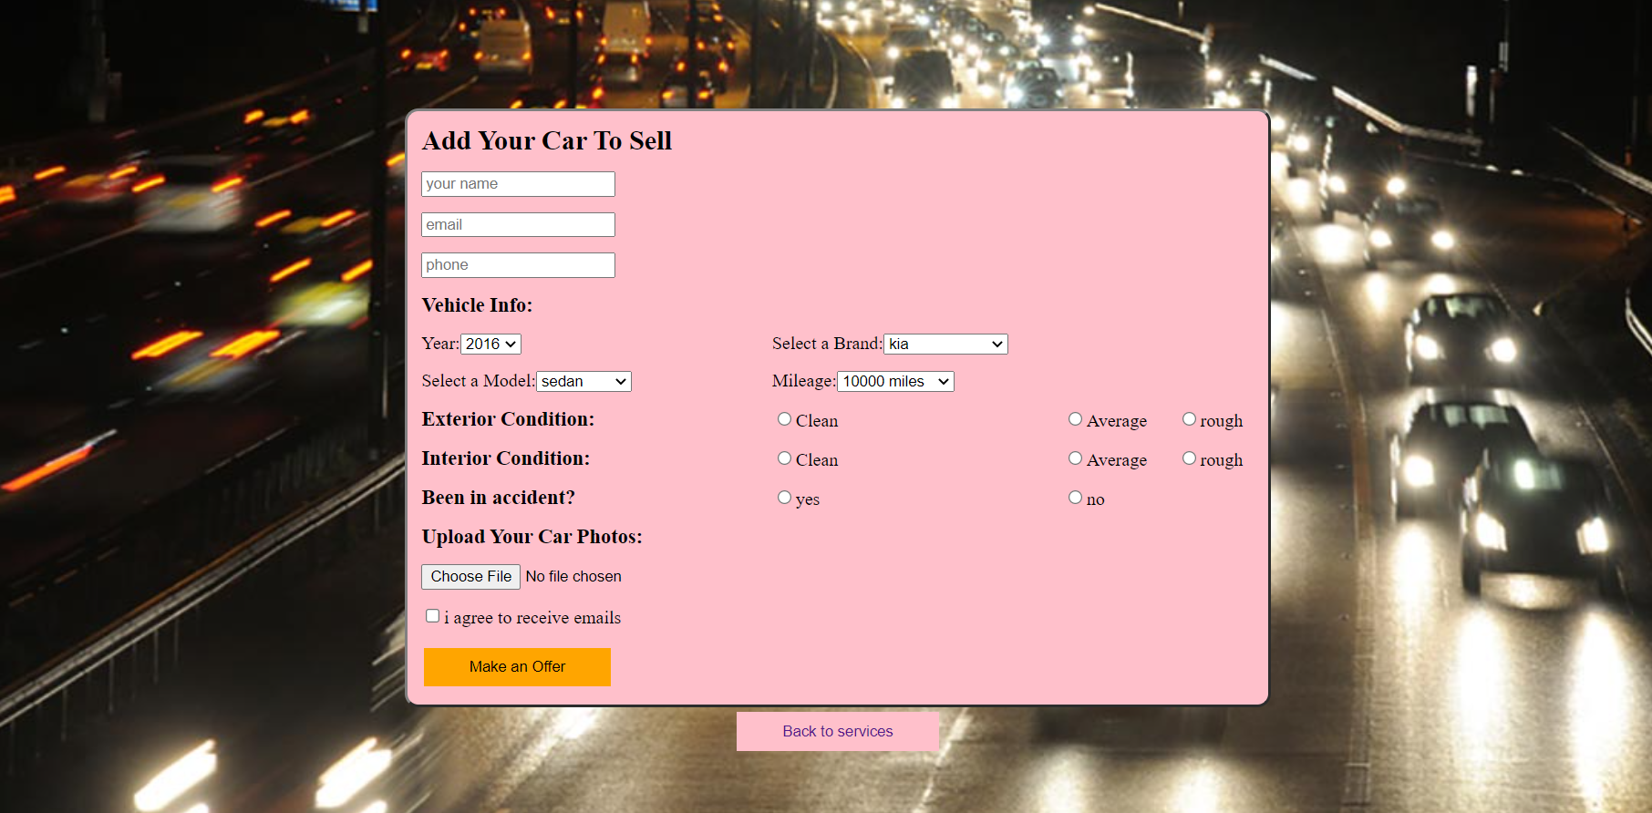
CAR SELLING

Slide 13
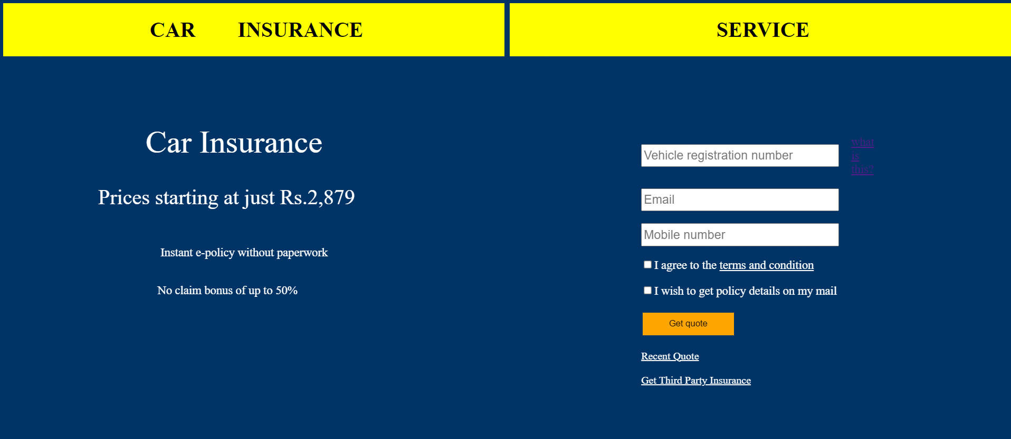
CAR INSURANCE

Slide 14
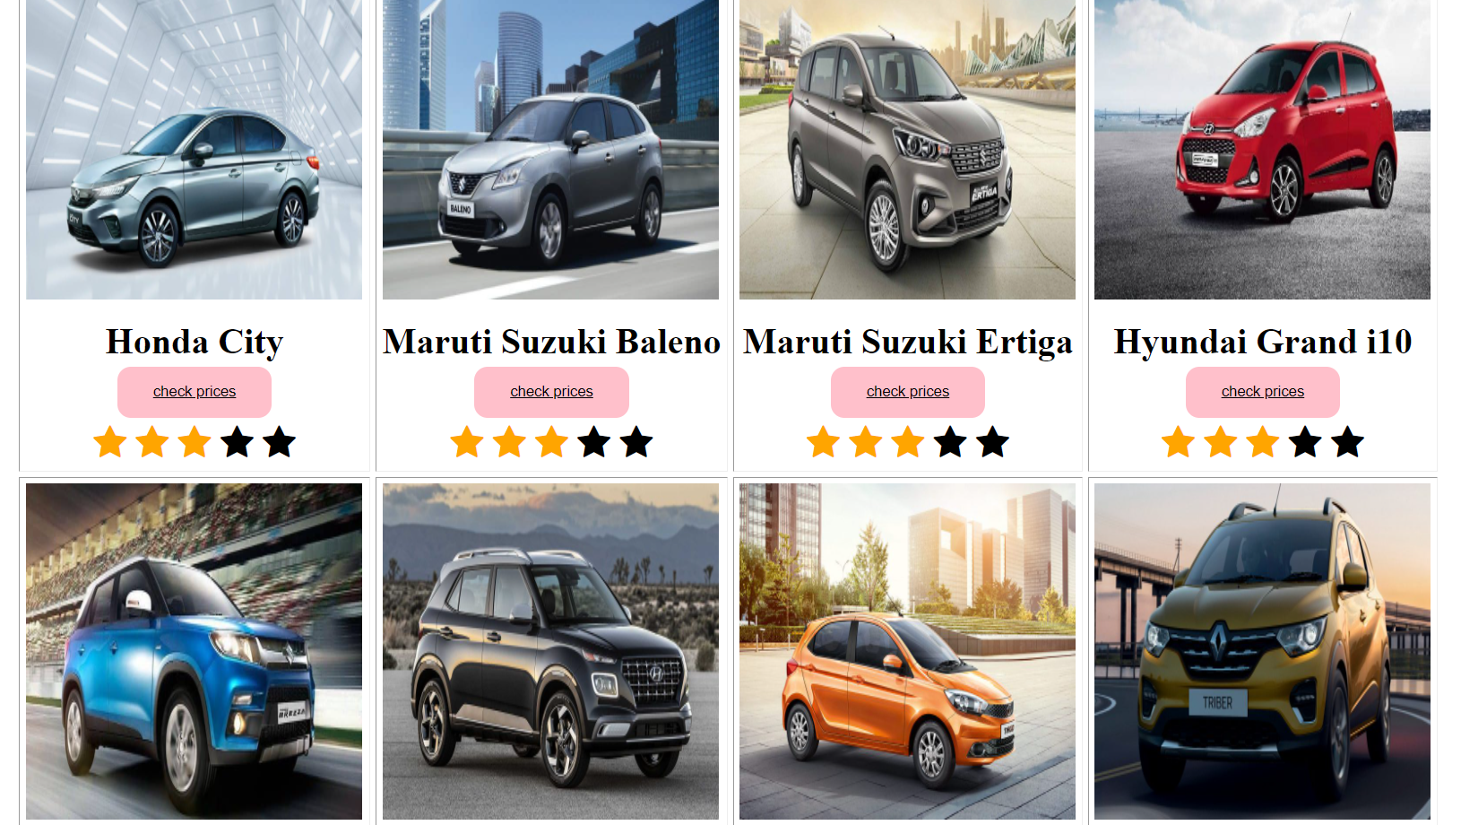
FEATURED CARS

Slide 15
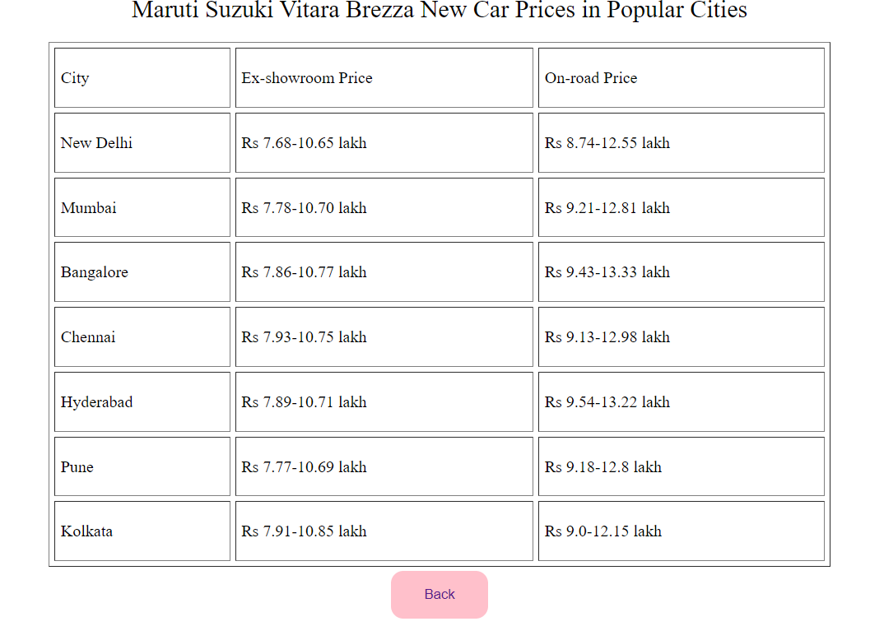
PRICES OF CARS

Slide 16
PRICES CODE
<html>
<head>
<style>
a{text-decoration:none;}
button:hover{
opacity:0.8;
}
button{border-radius:12px}
.button{
background-color: pink;
border: none;
padding: 15px 32px;
text-align:center;
text-decoration: none;
display: inline-block;
margin: 4px 2px;
cursor: pointer;
}
</style>
</head>
<body>
<center><font size="5" > Maruti Suzuki Vitara Brezza New Car Prices in Popular Cities </font></center>
<br>
<table width="50%" height="70%" cellspacing="5" cellpadding="5" border="1" align="center">
<tr>
<td> City </td>
<td>Ex-showroom Price </td>
<td> On-road Price</td>
</tr>
<tr><td>New Delhi</td><td>Rs 7.68-10.65 lakh</td><td>Rs 8.74-12.55 lakh</td></tr>
<tr><td>Mumbai</td><td>Rs 7.78-10.70 lakh</td><td>Rs 9.21-12.81 lakh</td></tr>
<tr><td>Bangalore</td><td>Rs 7.86-10.77 lakh</td><td>Rs 9.43-13.33 lakh</td></tr>
<tr><td>Chennai</td><td>Rs 7.93-10.75 lakh</td><td>Rs 9.13-12.98 lakh</td></tr>
<tr><td>Hyderabad</td><td>Rs 7.89-10.71 lakh</td><td>Rs 9.54-13.22 lakh</td></tr>
<tr><td>Pune</td><td>Rs 7.77-10.69 lakh</td><td>Rs 9.18-12.8 lakh</td></tr>
<tr><td>Kolkata</td><td>Rs 7.91-10.85 lakh</td><td>Rs 9.0-12.15 lakh</td></tr>
</table>
<center>
<button class="button"><a href="features.html">Back</a></button>
</center>
</body>
</html>

Slide 17
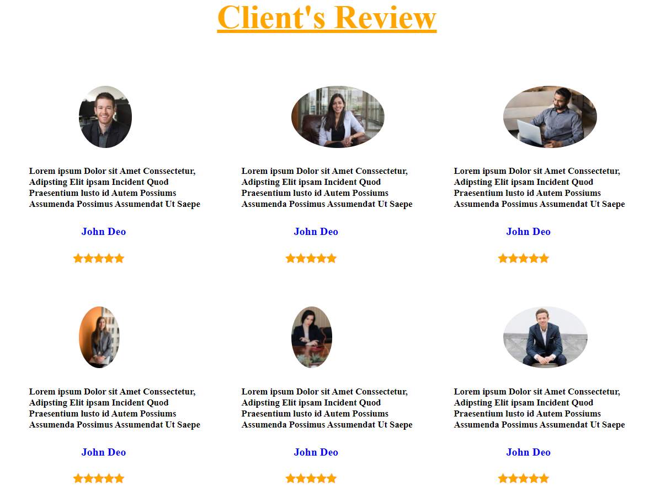
CARS REVIEWS

Slide 18
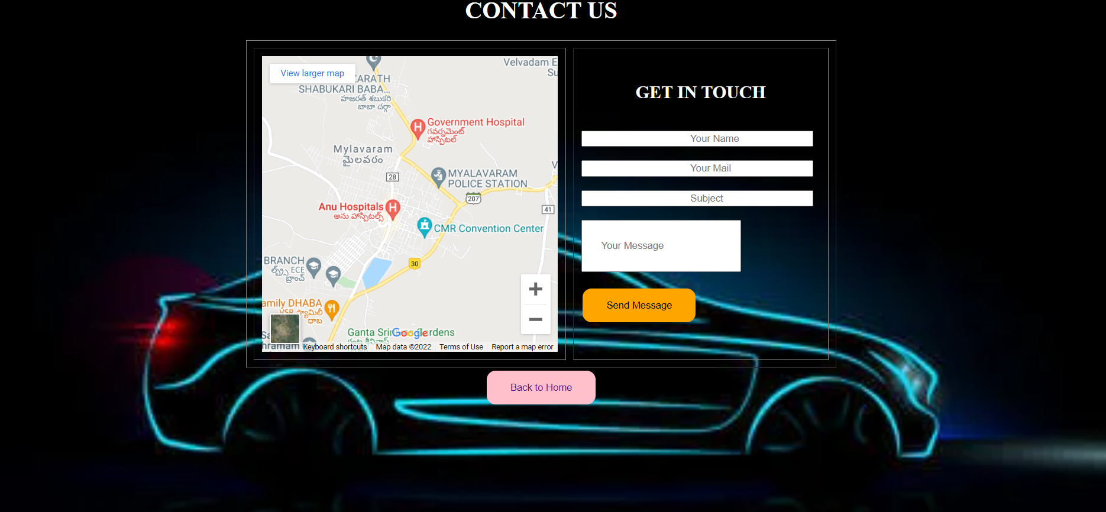
CONTACT US

Slide 19
CONTACT US CODE
<html>
<head>
<style>
a{text-decoration:none;}
body
{
background-image:url("carimg1.jpg");
background-size:100%;
background-attachment:fixed;
background-repeat:no-repeat;
}
button:hover{
opacity:0.8;
}
button{border-radius:12px}
.button{
background-color: orange;
border: none;
padding: 15px 32px;
text-align:center;
text-decoration: none;
display: inline-block;
margin: 4px 2px;
cursor: pointer;
}
.button1{
background-color: pink;
border: none;
padding: 15px 32px;
text-align:center;
text-decoration: none;
display: inline-block;
margin: 4px 2px;
cursor: pointer;
}
</style>
</head>
<body>
<center>
<center><h1> <b><font color="white">CONTACT US</font></b></h1></center>
<table border="1" cellspacing="10px" cellpadding="10px" >
<tr><td> <iframe src="https://www.google.com/maps/embed?pb=!1m14!1m12!1m3!1d15281.480957952157!2d80.64364975!3d16.75824565!2m3!1f0!2f0!3f0!3m2!1i1024!2i768!4f13.1!5e0!3m2!1sen!2sin!4v1643881542305!5m2!1sen!2sin" width="400" height="400" style="border:0;" allowfullscreen="" loading="lazy"></iframe>
</td>
<td width="45%">
<center><b><h2><font color="white"> GET IN TOUCH</font></h2></b> </center>
<br>
<input type="text" name="xt" placeholder="Your Name" style="padding-left:45%"><br>
<br>
<input type="email" name="yi" placeholder="Your Mail" style="padding-left:45%"><br>
<br>
<input type="text" name="so" placeholder="Subject" style="padding-left:45%"><br>
<br>
<input type="text" name="sz" placeholder="Your Message" style=" padding:25px"><br>
<br>
<button class="button"><font color="black">Send Message</font></button>
<br>
</center>
</td>
</tr>
</table>
<center>
<button class="button1"><a href="projecthome.html">Back to Home</a></button>
</center>
</body>
</html>

Slide 20
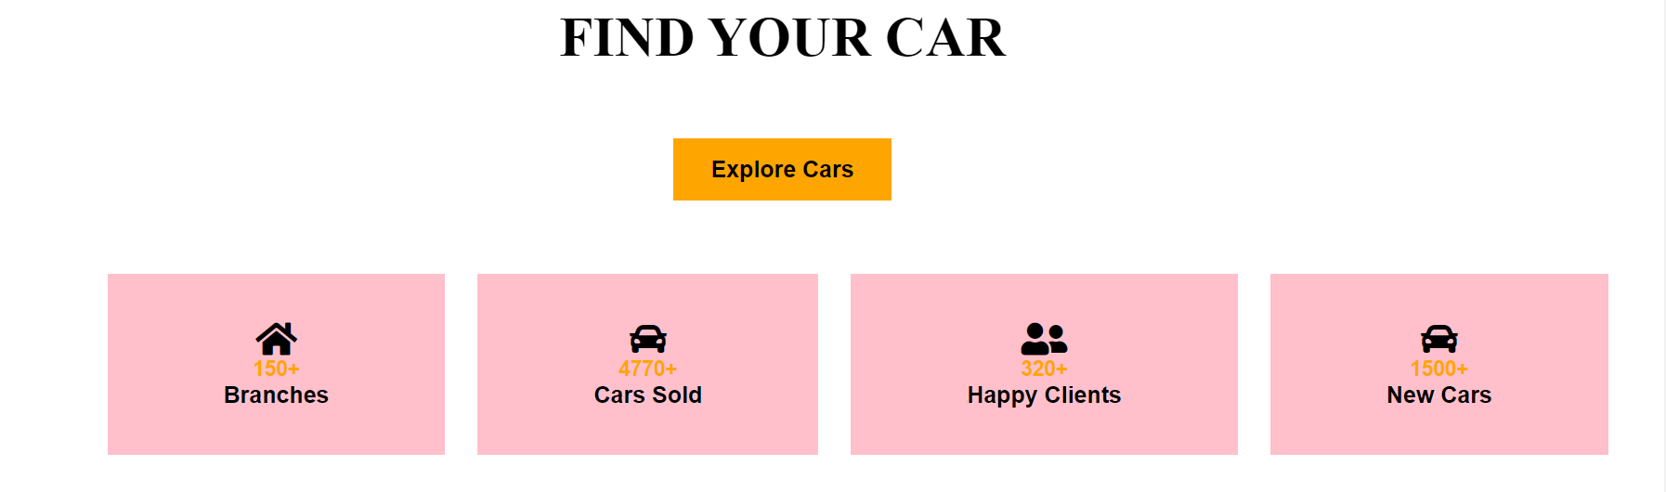
EXPLORE CARS

Slide 21
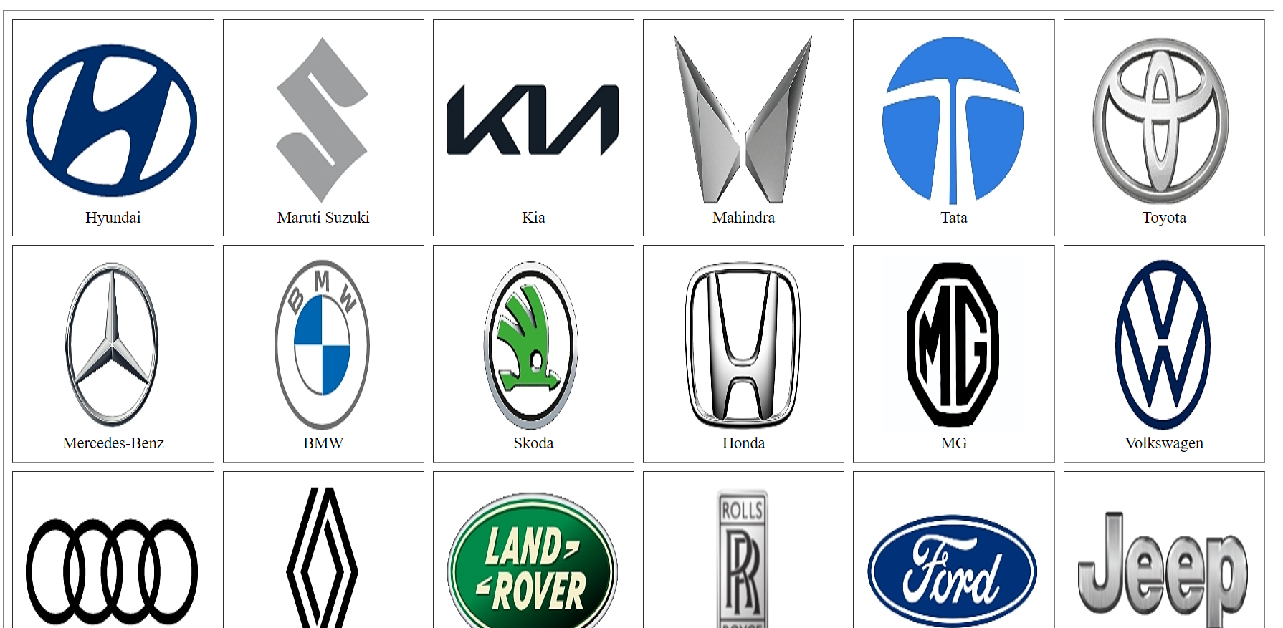
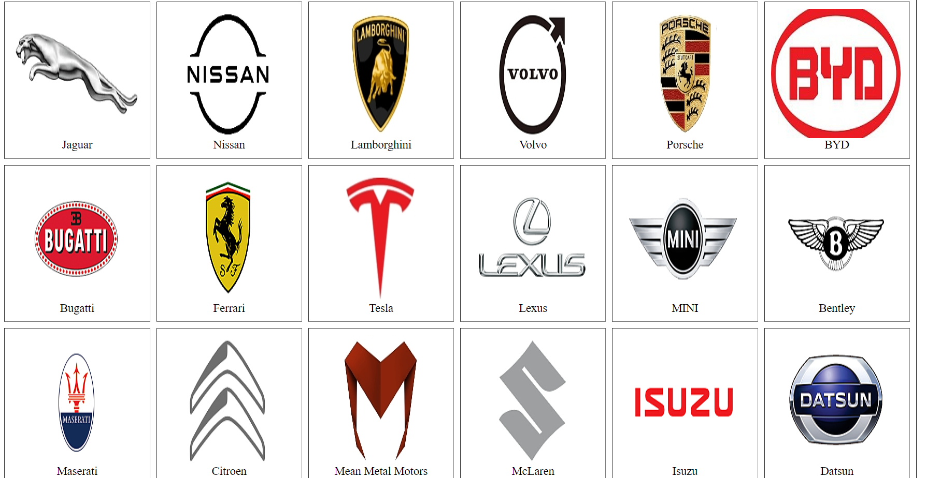
BRANDS

Slide 22
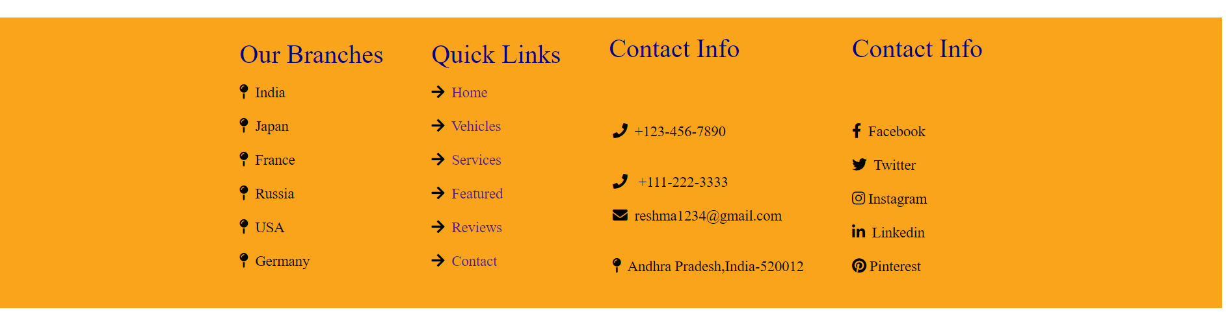
LAST PAGE OF WEBSITE

Slide 23
HTML and CSS tags used in this website:
Head tag
Script tag
Body tag
Classes and id based selectors
Internal and inline css
Tables
Forms
Images
Body tag
Borders and alignments
Text-decorations

Slide 24

LAKIREDDY BALIREDDY COLLEGE OF ENGINEERING
PRESENTED BY:
Nelli Reshma
CSE Department
20761A05A8
UNDER THE GUIDANCE OF:
MS.K.DeviPriya(Sr.Asst Professor)

Slide 25
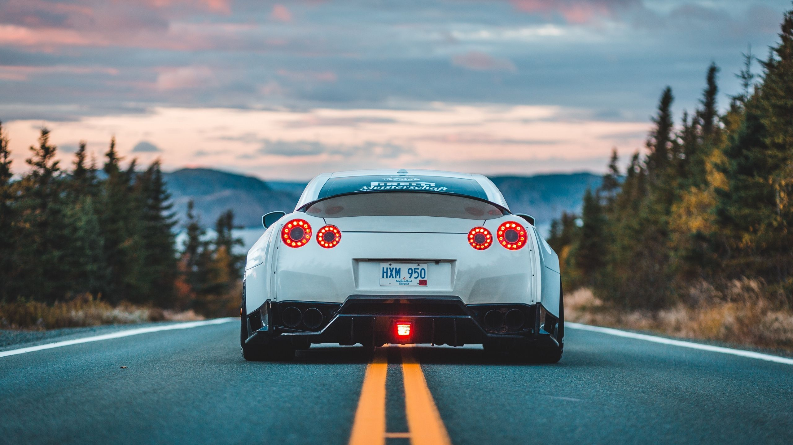
THANK YOU

